Slide 1

DATABASE MODEL USING A TOOL TO CREATE ERD
WEB APPLICATION DEVELOPMENT TRAINING

Slide 2
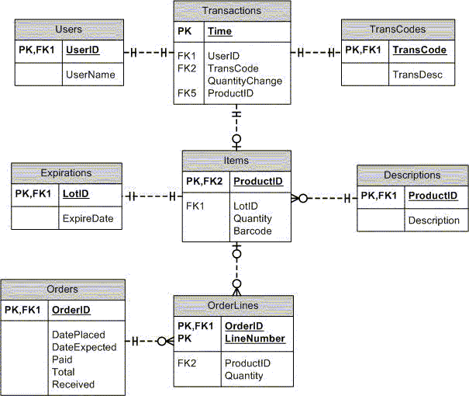
MySQL Workbench
  In today class, we will work through the steps necessary to design a simple schema using MySQL Workbench
  And then generate a SQL script and feed it through to a database server to create the corresponding physical database..

Slide 3
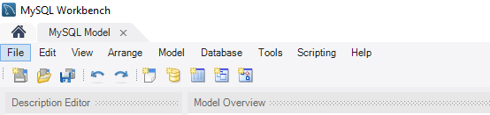
Creating a New Model
  To create a new model, start the MySQL Workbench tool
  And click on the File Menu then New Model sub menu.
  A new panel will be added to the workbench labeled
  MySQL Model:

Slide 4
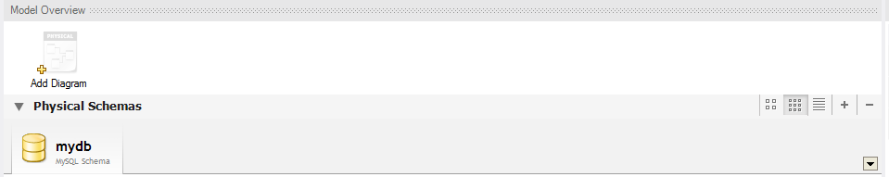
Creating a New Model
  A model can contain multiple schemata.
  Note that when you create a new model, it contains the mydb schema by default.
  You can change the name of this schema to serve your own purposes, or delete it.

Slide 5
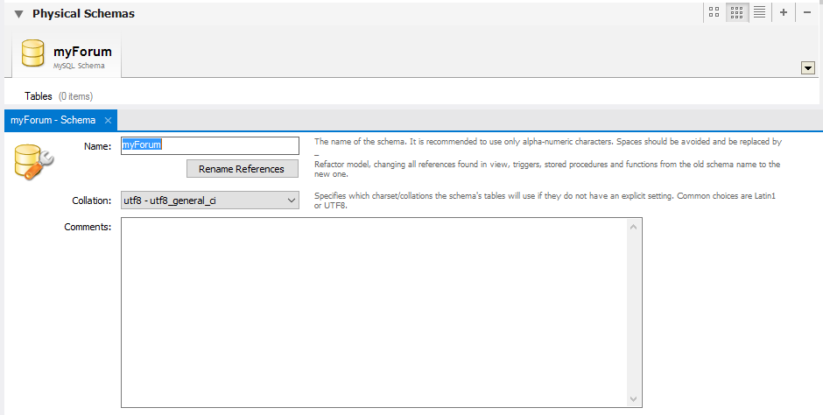
Creating a New Model
  Begin the modeling process by double clicking on the
  tab labeled mydb MySQL Schema.
  In the resulting properties panel change the name of the schema to myForum.

Slide 6
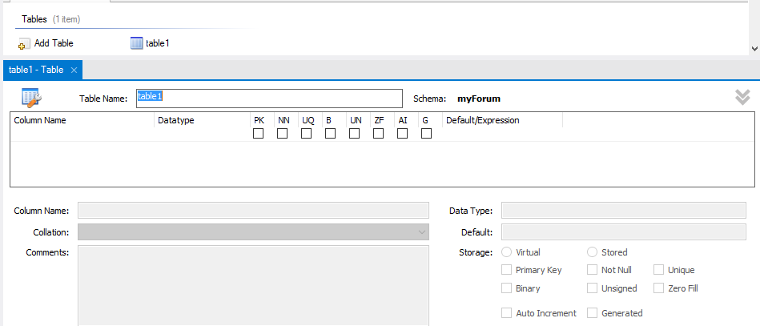
Creating a New Model
  Close the schema property panel by clicking on the small “x” next in the Schema tab.
  Having given our schema a name, we can now add a table to the model.This is achieved by double clicking on the Add Table button in the Tables panel:

Slide 7
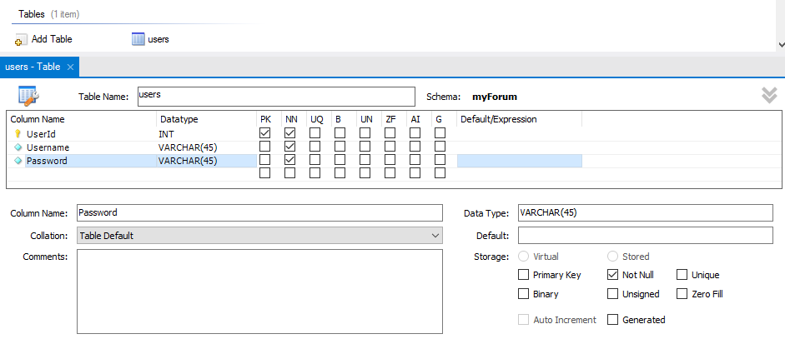
Creating a New Model
  In this exercise, we are creating 3 tables in myForum Schema. Namely, users, threads and posts.
  Change the table name to users and then select the Columns tab to begin the process of adding columns to the table:

Slide 8
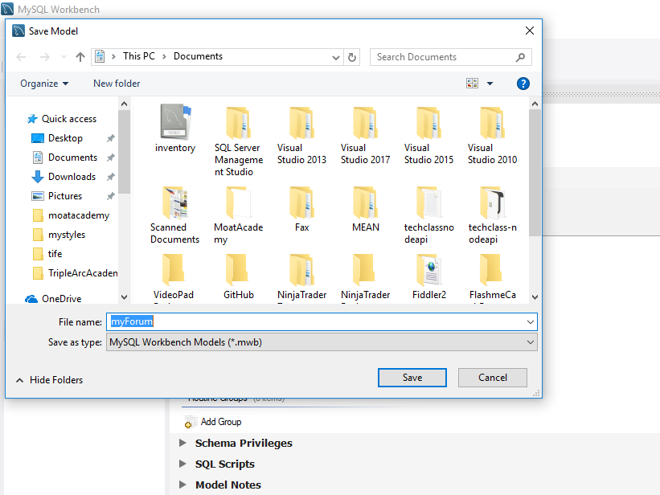
Creating a New Model
  Before proceeding, save the model using the File -> Save Model menu item, or using the appropriate toolbar button.

Slide 9
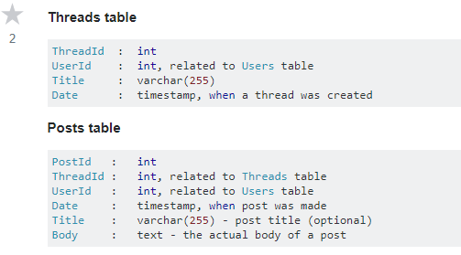
Creating a New Model
  Proceed to add other 2 tables Threads & then Posts using the following table structure.

Slide 10
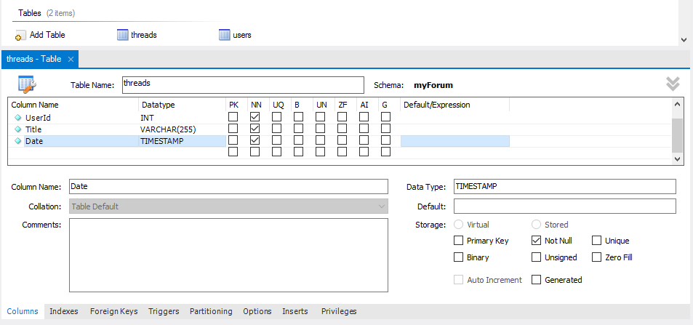
Creating a New Model
  Proceed to add other 2 tables Threads & then Posts using the following table structure.

Slide 11
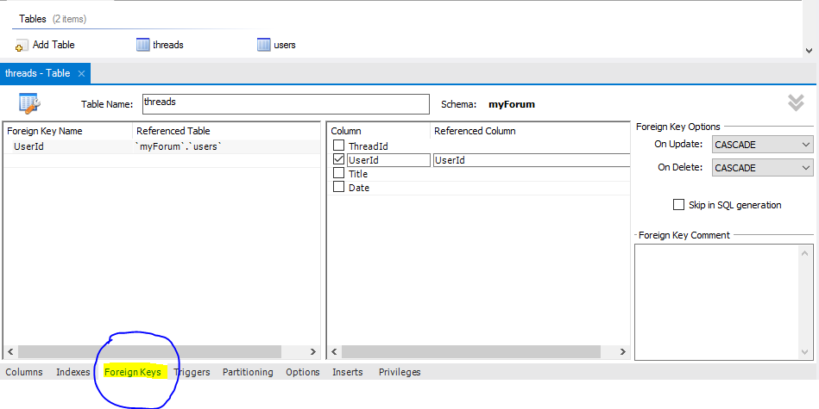
Creating a New Model
  Create Foreign Key by selecting foreign keys tab
  at the bottom of Threads table creation panel.

Slide 12
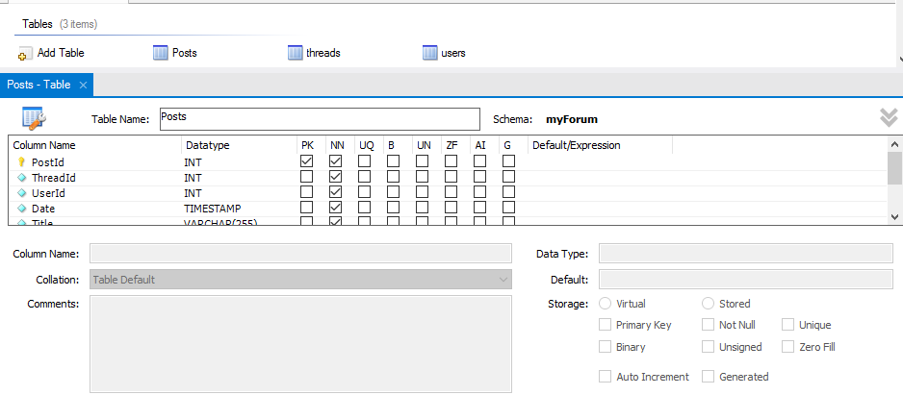
Creating a New Model
  Create Posts Table.

Slide 13
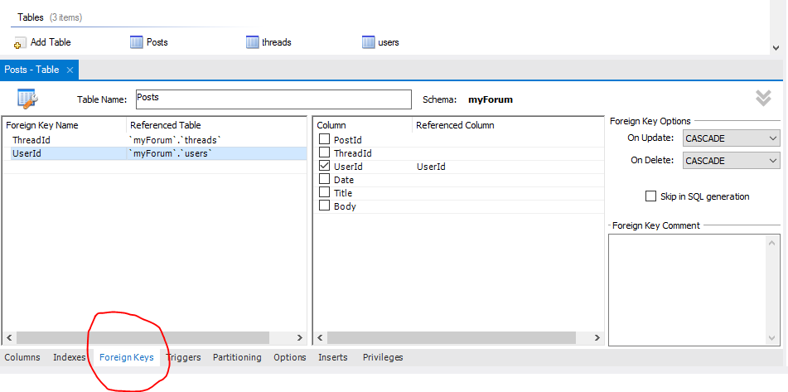
Creating a New Model
  Create Posts Table Foreign Keys by selecting foreign keys tab at the bottom of Threads table panel.

Slide 14
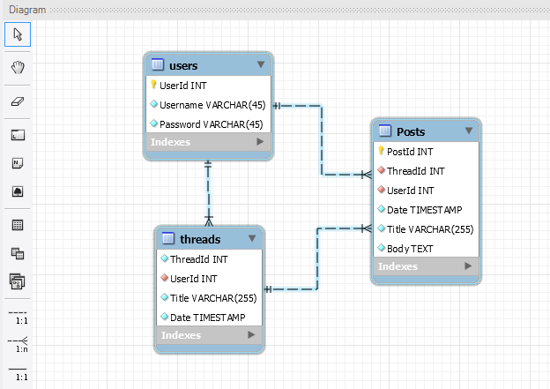
Generating a Model Diagram
  To generate an EER diagram of our model, select the Model ->Create Diagram from Catalog Objects sub-menu option.The diagram illustrated in the following figure will then be generated:

Slide 15
Generating a Script and
Creating a Database
  Having created a model, the next step is to generate a SQL script from the model and feed it through to a database server where it will be executed to create the physical database and table.
  To achieve this, select the Database -> Forward Engineer… menu option.
  In the resulting dialog, a range of selections are available to filter and modify the script that will ultimately be generated.
  In this myForum Schema example, and all we have to generate is table information, select only the Export MySQL Table Objects option and click Next to review the generated SQL script:

Slide 16
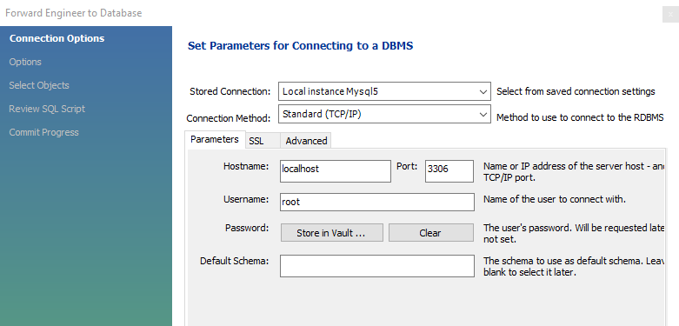

Generating a Script and
Creating a Database
  Select your stored connection and
  Click on next button to proceed

Slide 17
Generating a Script and
Creating a Database
  Select your stored connection and
  Click on next button to proceed

Slide 18
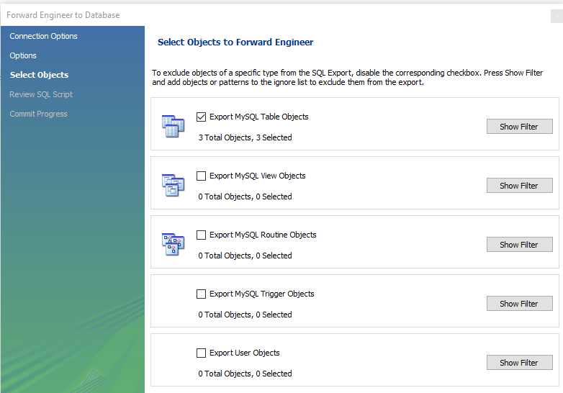
Generating a Script and
Creating a Database
  Select Objects to Forward Engineer and
  Click on next button to proceed

Slide 19
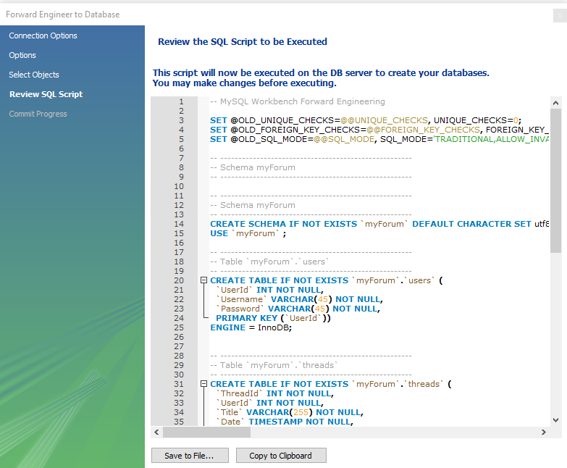
Generating a Script and
Creating a Database
  Review the SQL Script to be executed and
  Click on next button to proceed

Slide 20
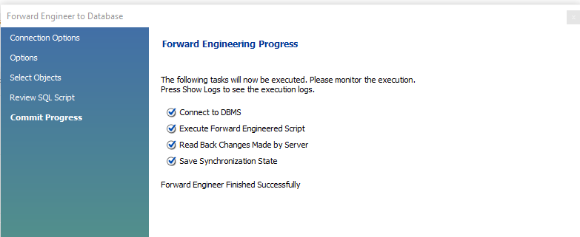

Generating a Script and
Creating a Database
  The success or otherwise of the execution will then be reported in the following screen.
  Assuming a successful operation, the new database will now be present on the designated database server.

Slide 21
Reverse Engineering an Existing Database
  A model may also be generated from an existing database. This concept is referred to as reverse engineering.
  To reverse engineer an existing database,
  select the Create EER Model from Existing Database link from the Database Modeling column of the MySQL Workbench home screen
  and configure the connection to the desired database server in the resulting dialog.
  Having connected successfully and fetched the database information proceed to the next screen to select the schemata to be reverse engineered.

